Slide 1
313 – Security Challenges in Healthcare IoT
Marco Ermini, CISSP, CISA, CISM – Senior IT Security Analyst – ResMed

Slide 2
Agenda
Context: CPS, Industry 4.0, IoT, Security Challenges
Threat Model for Medical IoT Devices
Regulatory background for Cybersecurity on Medical Devices
Suggestions for improvements

Slide 3
CPS, Industry 4.0, IoT, Security Challenges

Slide 4
Context for IoT
Marc Andreessen’s “Software is eating the world” (2011)
Software companies take over the economy
Industries are disrupted by software
Technology required to transformed industry via software is available on a global scale
Software eats up chain value of “physical” industries
In every industry, companies need to assume that a software revolution is coming
Agile management practices
Agile, Scrum, Continuous Delivery
Transition from software into other sectors
Notes:
Marc Andreessen, WSJ, 2011
“we are in the middle of a dramatic and broad technological and economic shift in which software companies are poised to take over large swathes of the economy.”
“industries to be disrupted by software”
“all of the technology required to transform industries through software finally works and can be widely delivered at global scale.”
World's largest bookseller, Amazon, is a software company
largest video service by number of subscribers is a software company: Netflix.
dominant music companies are software companies, too: Apple's iTunes, Spotify and Pandora.
fastest growing entertainment companies are videogame makers
best new movie production company in many decades, Pixar, was a software company
largest direct marketing platform is a software company—Google
Today's fastest growing telecom company is Skype – CenturyLink declines at 7% rate yearly
“Tyres as a service” – Pirelli and Michelin. No more 4/5 years dealers’ contracts
Software is also eating much of the value chain of industries that are widely viewed as primarily existing in the physical world
Cars, logistics at Wal-Mart, FedEx, oil and gas, agriculture, financial services, etc.
the agile management practices developed in software under headings like Agile, Scrum and Continuous Delivery, are now appearing in other sectors, such as auto manufacturing, routers, hydraulics, groceries, retail, and many more.

Slide 5
Notes:
3rd phase has literally “hundreds of different protocols used by these devices. They may have very specific needs in terms of speed and frequency of connectivity. Many of them are super susceptible to changes in delay and latency, some of them connect intermittently, while some others just come in range from time to time. Many operate 24x7 under the harshest conditions, and a lot of them where designed to operate in hierarchical and closed loop networks.” (Cisco)
Need for 4.0
on-demand manufacturing
high-efficiency
Virtual prototyping
Mass customisation
Convergence of ICT protocols between industrial and non-industrial
T-shaped skill profiles: IT, electronics, robotics, biotech, nanotech, analytics specialists, engineers, programmers will all have to be able to think across business models, production processes, machine technology and data-related procedures)
Change of corporate culture: continuous learning and training mode, lifelong learning required
Light, decentralised footprint

Slide 6
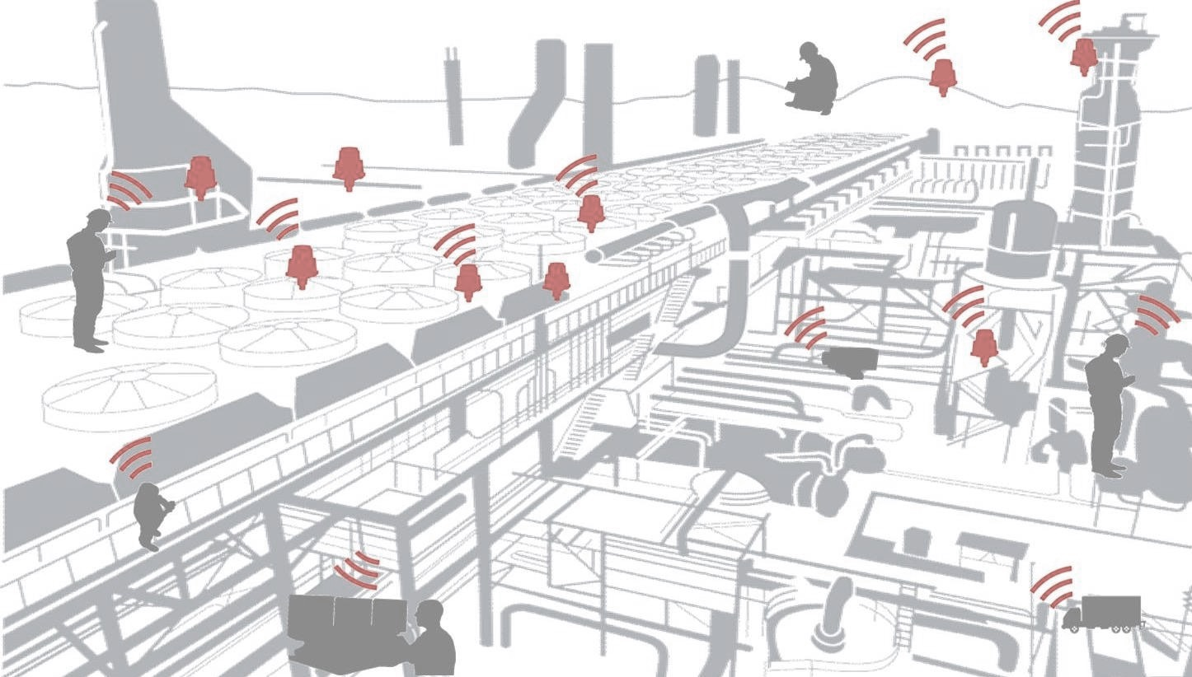
Cyber-Physical Systems (CPS)
Must satisfy those characteristics
Link between computational and physical element
“Smart”
Must talk together – are “networked”
Notes:
CPS - “Cyber-Physical Systems”: network objects which have electronics, sensors, mechatronics, etc. which can measure the world and react on those measures.
CPS evolved from embedded devices and mechatronic devices augmented with communication capabilities and connectivity. A CPS is therefore a system composed of physical entities such as mechanisms controlled or monitored by computer-based algorithms.
Precursors in aerospace, automotive, chemical processes, civil infrastructure, energy, healthcare, manufacturing, transportation, entertainment, and consumer appliances.
CPS involves transdisciplinary approaches, merging theory of cybernetics, mechatronic design, and design and process science. This generation is often referred to as embedded systems.

Slide 7
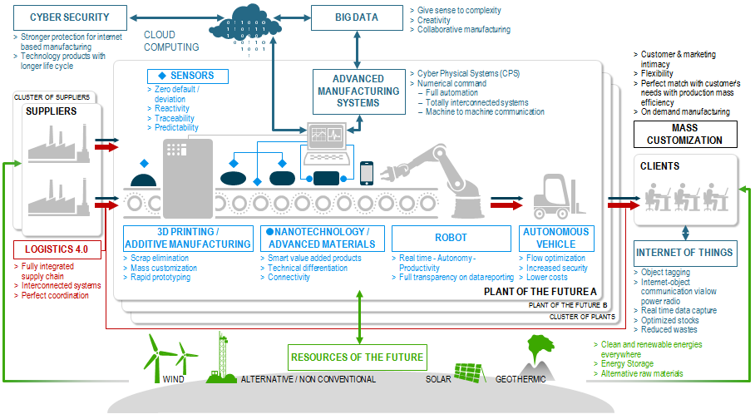
Industry 4.0 and CPS ecosystem
Interoperability
Virtualization
Decentralization
Real-Time Capability
Service Orientation
Modularity
Often connected with machine learning (AI)
Notes:
Industry 4.0 is different
Interoperability:
the ability of cyber-physical systems (i.e. workpiece carriers, assembly stations and products), humans and Smart Factories to connect and communicate with each other via the Internet of Things and the Internet of Services
Virtualization: a virtual copy of the Smart Factory which is created by linking sensor data (from monitoring physical processes) with virtual plant models and simulation models
Decentralization:
Ability of CPS within Smart Factories to make decisions on their own
Implies Remote Monitoring and Predictive Maintenance
Real-Time Capability:
Big Data: the capability to collect and analyse data and provide the derived insights immediately
On-demand, high-efficiency manufacturing, fragmentation of the value chain, mass-customisation
Service Orientation: offering of services (of cyber-physical systems, humans or Smart Factories) via the Internet of Services
Modularity: flexible adaptation of Smart Factories to changing requirements by replacing or expanding individual modules
Industry 4.0 imposes connection to the internet.
AI: Supervised and unsupervised learning, Neural Networks, Machine Learning, System Design, etc.

Slide 8

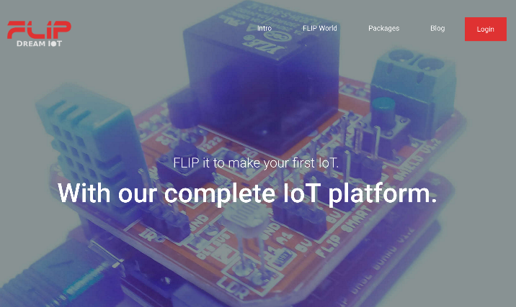
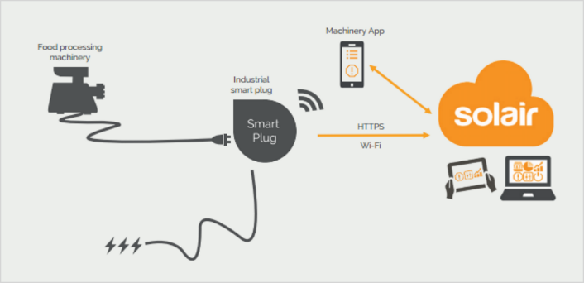
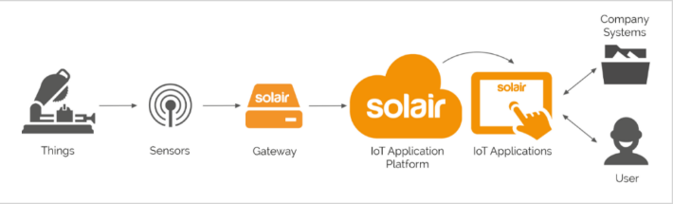
Notes:
Solair acquired by Microsoft, to be incorporated into Azure for IoT.
Easy and fast configuration
IaaS, High scalability, HA
Enterprise security protocols
Self-made or provided hardware
Agnostic to connection
YUMI robots are replacing old robotics, designed to work along with humans. YUMI are by nature networked. YUMI has an app store.
FLIP has rule engine on backend, programmable in Python, building blocks in Raspberry PI and Arduino with sensors. Can build Health App from 6000 USD (plus 6000 USD basic training course).

Slide 9
Definition of IoT
Link between computational and physical element – “CPS”
“Smart”
Must talk together – are “networked”
Notes:
CPS - “Cyber-Physical Systems”: network objects which have electronics, sensors, etc. which can measure the world and react on those measures.
In embedded systems the emphasis tends to be more on the computational elements, and less on an intense link between the computational and physical elements. CPS is also similar to the Internet of Things (IoT) sharing the same basic architecture, nevertheless, CPS presents a higher combination and coordination between physical and computational elements.
“Smart”, have some kind of programmable and flexible logic, can become “personal”. Often are personal things. Mobile is the centre. Smartwatches, and things becoming more common, toothbrush, rings, etc. Home things: “smart” TV, light bulbs, fridges, washing machines, dishwashers, ovens. Fridge can check RFID tag and tell you that milk is finished - or order it directly at Amazon. Your calendar can order your Uber car or in five years, a self driving car, to bring you to your next appointment.
“Networked” – they talk together and get information from that. Network Objects are there already since a long time, what is different is that we networked together.
Medical things - insulin pumps, defibrillators, blood pressure. Devices can adjust and regulate each others’. Fit bands.

Slide 10
Definition of IoT
Classification
Industrial/Manufacturing applications
Energy
Military
Robotics
Infrastructure
Insurance
Health Care
Consumer Products
Wearables
Media
Home Automation
Smart Appliances
Notes:
Medical things borderline with consumer products - insulin pumps, defibrillators, blood pressure. Devices can adjust and regulate each others’. Fit bands.

Slide 11
IoT Security Challenges
Complex attack surface
Device itself
Apps
Backend
Specificities:
Interaction
Patching
Physical
Market acceleration
No standardisation
Notes:
Attack Surface
IoT security is not (just) about device security. Mobile security is: mobile device, installed apps, 3rd party app backend, pre-installed apps back-end. Same thing with IoT. Attack surface is not just the surface of the device. Threat modelling is necessary - who is going to do what? how many ingress and egress point are present? IoT is nothing new. OWASP top 10 for IoT - same ones of the web and mobile.
Some are specific, such as what is related to software/firmware and poor physical device.
Interaction: TV is talking to the kitchen to program media when the dinner is ready. Push towards IPv6
Difficult to patch. - Updating and patching web application - relatively easy. - Mobile phones = initially difficult, now easy. - Cars = very difficult, they can stay unpatched for 15 years. They are going to be out there for a very long time and will not be patched. Devices need to be recalled to the vendor (e.g. all cars except for some vendors). If there is an update capability, it is often unsecure.
Physical security: my car is parked far from me, in an airport. My sensor (e.g. camera) when external, has poor physical security and it is potentially an ingress point to the internal network.
Number of devices – 6 billions in 2016, 20.8/26 billions by 2020 - maybe underestimate? Fragmentation and complexity - how do you recover old applications which are not patchable? No economic incentive to secure, only to implement as fast as possible.
No standard for IoT security – and hospital devices

Slide 12
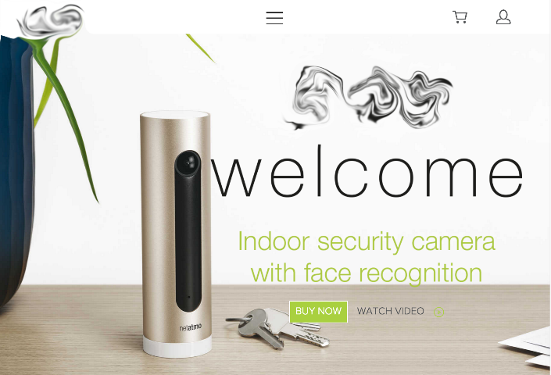
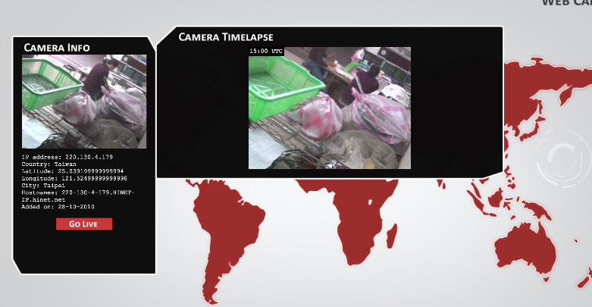
IoT Security Challenges
What could go wrong?...
Notes:
Shodan Webcam browser

Slide 13
Threat Model for Medical IoT Devices

Slide 14

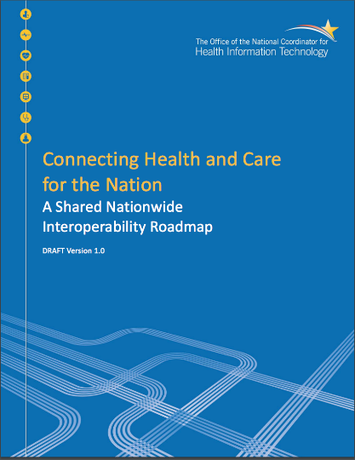
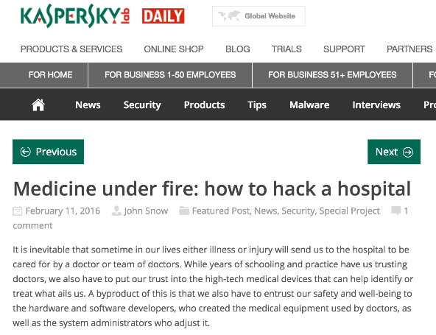
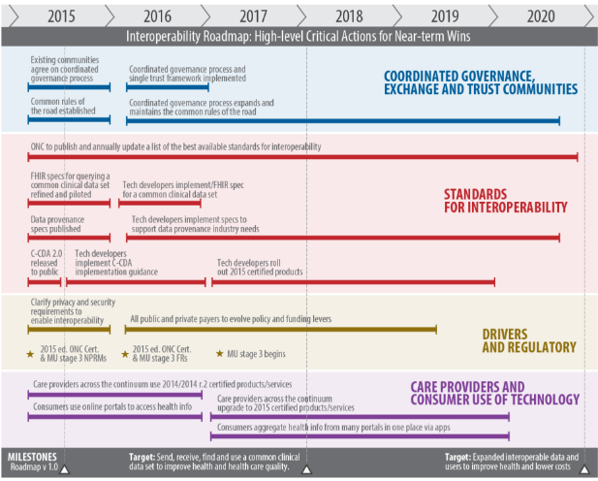
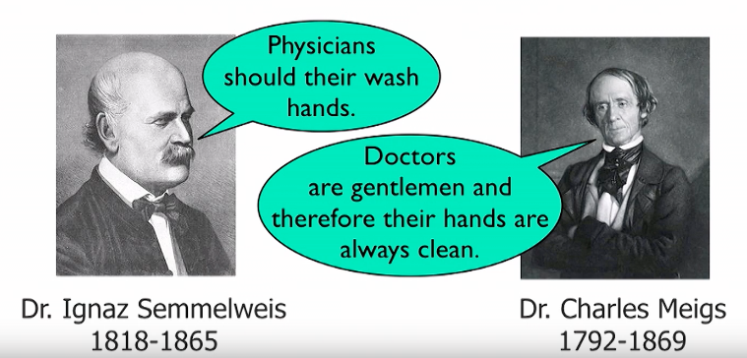
Risks for Medical IoT Devices
E2E data lifecycle protection risks
Physical security
Orchestration issues
Lack of standardisation
Platform(s) security
Disruption from Cybersecurity attacks
Denial of Cybersecurity issues from device manufacturers
“Security is always secondary after safety”
Security bolted-in, rather than coming by design
Lack of Visible and Usable Security & Privacy
“Internet of someone else’s Thing”
Notes:
E2E: various data is generated from many things and is spontaneously shared with other things including cloud under public net- work. Therefore, it requires the data protection framework to control and manage privacy information and confidential data in full data life-cycle.
Orchestration/standardisation: U.S. Department of Health and Human Services (HHS) 10 years plan to standardisation
Use existing IT infrastructure
Adapt to the context “one size does not fit all”
Usable from individuals
Leverage market
Simplify
Modularity
Focus on value
Protect privacy and security – HIPAA rules
Cybersecurity attacks – Denial: Kevin Fu presentation “USENIX Enigma 2016 - Medical Device Security”
Disruption: unavailability of patient care
Integrity of sensors
Not really intruders
Confidentiality is roughly equivalent to privacy, as it is a device’s ability to safeguard its data from unapproved access. An example of confidentiality would be only allowing the access of patient data to an approved user, such as the patient’s doctor.

Slide 15
Attack Vectors for Medical IoT Devices
Network Security
Direct PCB Attacks / Physical security
Interfaces
Applications
Backend
Software Updates
Notes:
PCB = Printed Circuit Board
Applications/Backend = E2E data lifecycle protection missing

Slide 16
Network Connectivity
Wi-Fi
Bluetooth/Bluetooth LE
Home Automation (ZigBee / Z-Wave / X10)
Cellular (2/3/4/5G, M2M)
“Low Power” networking (LoRa, LTE-M, Sigfox, NarrowBand)
Ethernet / Serial over Ethernet
“Industrial” protocols
DeviceNet (CAN)
ControlNet
Profibus (PROFINET)
Modbus
…
Notes:
Low Power: Tele2 in Nordics with LoRa, Vodafone/Huawei with LTE-M/4.5G “Cellular IoT”, Sigfox France/Spain/USA, NarrowBand IoT (Nokia/Intel/Ericsson/3GPP), etc.
Serial over Ethernet = code alarm of medical devices sent via serial ports; now RS232, RS422 or RS485 over IP – FlexiBus software, console servers, StarTech.
ControlNet: Built on its own physical and data link layer, ControlNet uses a single media link with (inexpensive) RG-6 coaxial cables and bus. It features a 5­Mbits/s speed, upload/download of data, P2P communication, and up to 99 nodes.
DeviceNet: Uses Controller Area Network (CAN-bus) as a backbone for physical and data link layer. CAN-bus consists of a host processor, a controller, and a transceiver linked by 2 twisted pair cables. Bit rates go from 1 Mbit/s at 40 m to 20 Kbit/s at 1200 m. DeviceNet uses the master/slave mode; it can have up to 64 nodes and the physical network can provide power to the devices (with limited consumption).
Modbus: Based on the master/slave mode and having up to 247 nodes, Modbus has many protocol versions depending on the physical layer being used. Every version uses the same base communication going from start, address, function, date, error check, and end.
Profibus: Using master-slave, slave-slave, and master-master communication on a bit serial field. The physical layer can be a twisted pair cable delivering power to the device and providing 9.6 kbit/s to 12 Mbit/s (maximum 1200 m) or an optical fiber cable.

Slide 17
Network Connectivity Attacks
Wi-Fi attacks
Bluetooth attacks
ZigBee attacks
Z-Wave “security by obscurity”
X10 intrinsic limitations
Cellular Network attacks
3/4G attacks
M2M attacks
Configuration mistakes
Industrial Protocols’ limitations
“Internet of S*it”, ”Internet of Stupid Things”, “Internet of Junk”
Notes:
Passive Interception
Active Interception
Impersonation
User tracking
Denial of Service
Insuline Pump with Telnet on port 23 giving root access
X10 has interception, interference issues and lacks encryption, and can only connect 256 devices
Shodan for Internet of Junk
https://www.youtube.com/watch?v=FmFLAlZO6ig

Slide 18
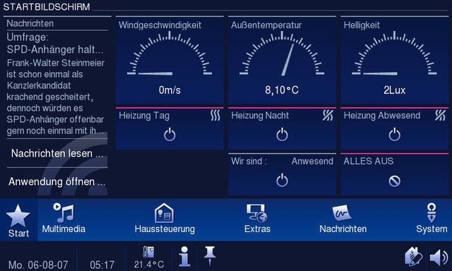
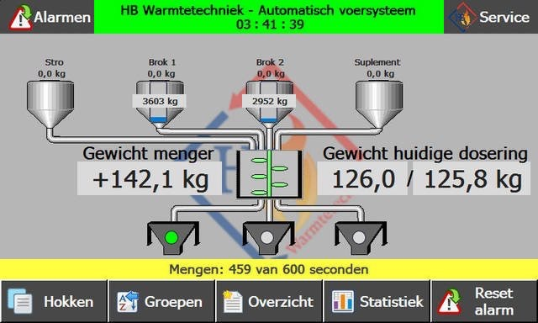
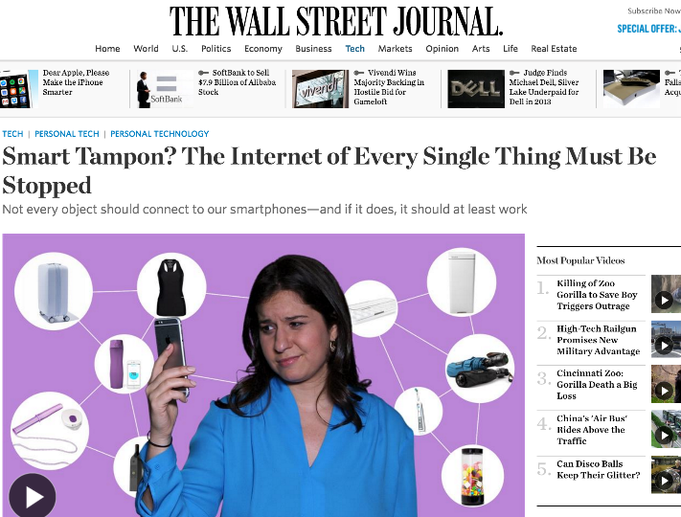
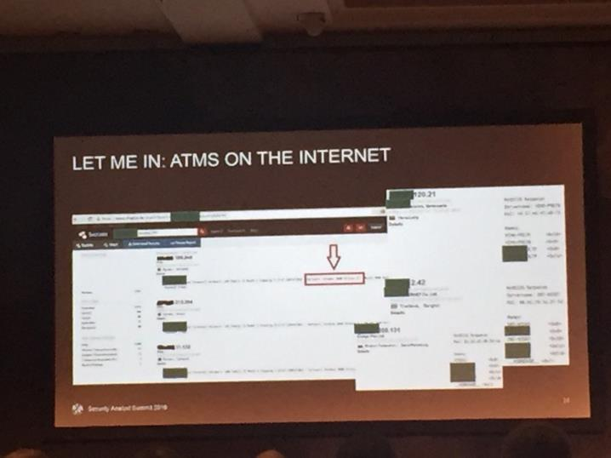
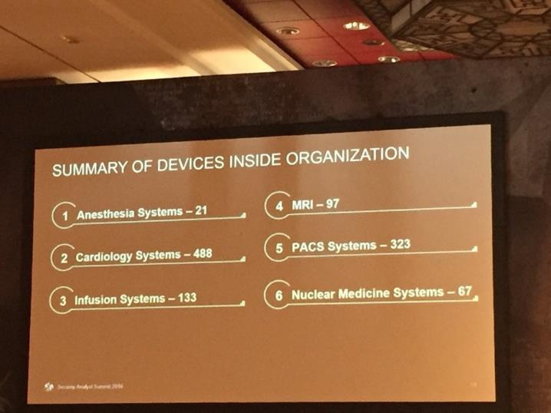
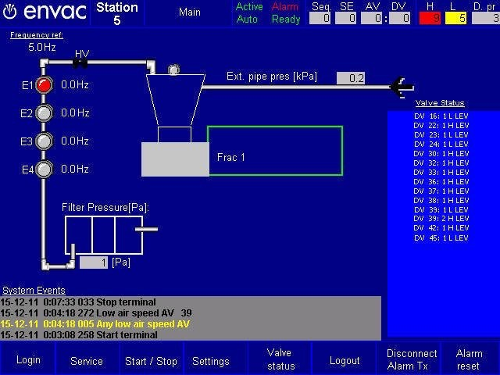
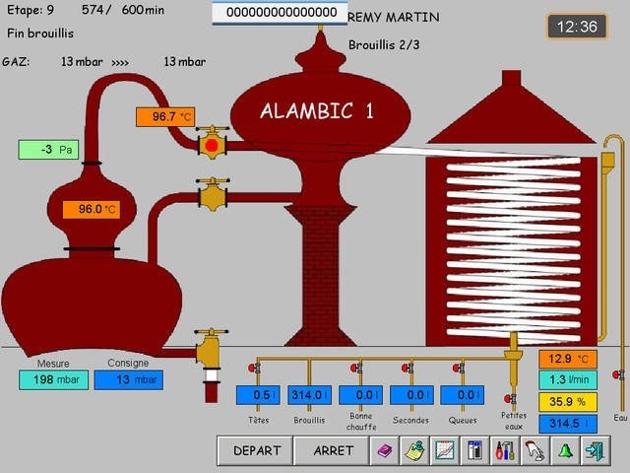
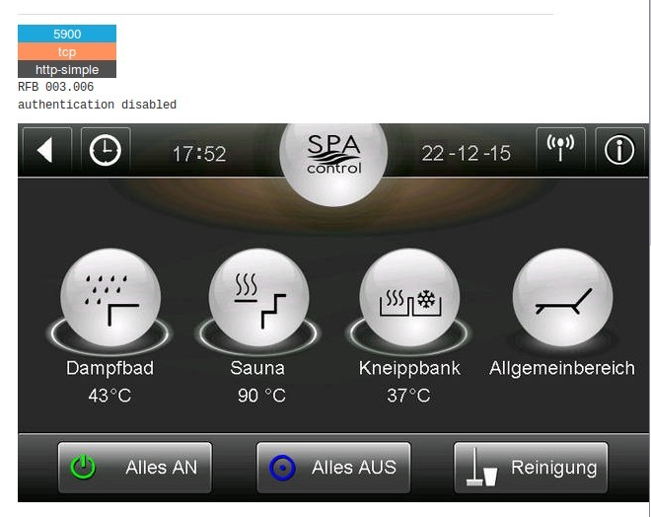
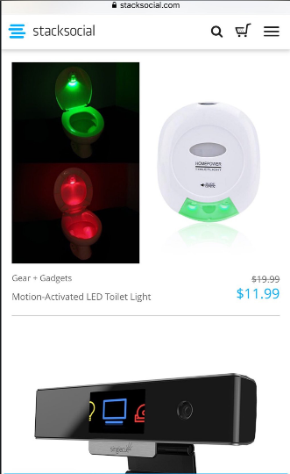
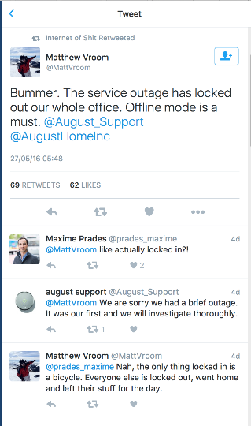
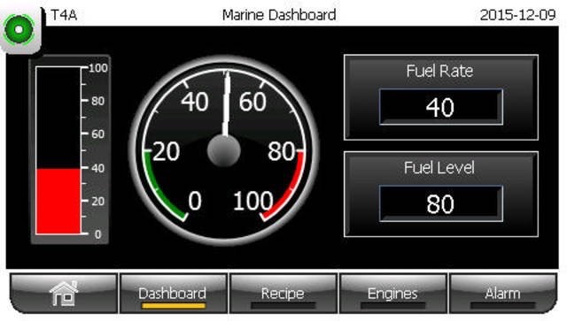
Internet of Junk
Notes:
(Funny digression in the Internet of Junk…)

Slide 19
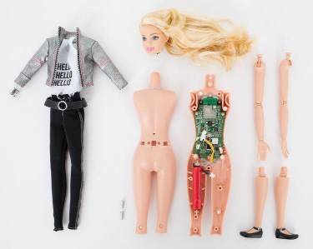
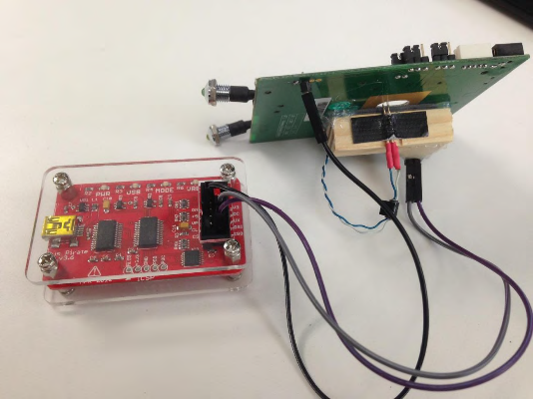
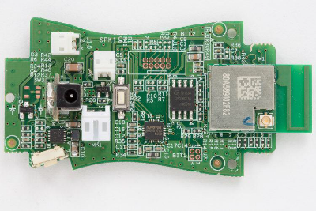
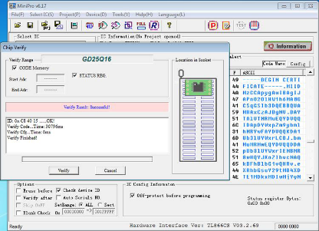
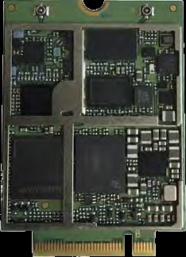
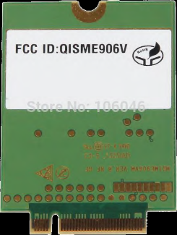

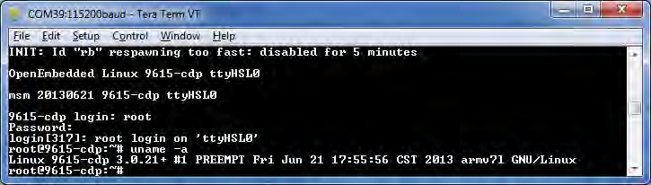
Direct PCB Attacks
Physical attacks can help intruders circumvent encryption
At least two attacks are generally possible on the PCB
Serial port
JTAG port
Internal Communication Modules can be attacked
e.g. LTE/4G modem modules
Notes:
Even if the data is encrypted, a certificate must be stored somewhere. Example of „Hello Barbie“/ToyTalk platform, hacked from JTAG port.
JTAG port + debugging headers on the PCB
Memory dump of the 16 Mbit FLASH memory – extract certificates
Discover insecure web services
Hack ToyTalk profit!
Smartwatches assume they are staying with us, but this is not agreed by pick-pickpocketers.
Internal communication modules
Dell/Huawei LTE/3G modem built-in into business class devices and medical devices
Presents itself to the MoBo as a USB interface
Plugged internally in the laptop or device
DEF CON 23 presentation on how it has been hacked
It is a self-contained Linux device – got root shell
Bad firmware update mechanism, was hacked, and researchers installed their own software that can act on the device/laptop, below the OS level

Slide 20
Interfaces’ Attacks
Tendency of moving care from facilities to home
USB attacks
“BadUSB” attacks on the host OS
Serial Ports on medical devices
Indirectly, what is the status of the healthcare facility’s network?
Serial-to-Ethernet or Serial-to-Wi-Fi converter
SANS Healthcare Cyber threat Report
Forced evolution over IPv6
81% of healthcare facilities in the US had a security incident
Notes:
The data analysed was alarming. It not only confirmed how vulnerable the industry had become, it also revealed how far behind industry-related cybersecurity strategies and controls have fallen.
During the sample period [09/2012 to 10/2013], the Norse threat intelligence infrastructure – a global network of sensors and honeypots that process and analyse over 100 terabytes of data daily – gathered data. The intelligence data collected for this sample included:
49,917 Unique Malicious Events
723 Unique Malicious Source IP addresses
375 U.S.-based health-care related organizations were compromised
A SANS examination of cyberthreat intelligence provided by Norse supports these statistics and conclusions, revealing exploited medical devices, conferencing systems, web servers, printers and edge security technologies all sending out malicious traffic from medical organizations. Some of these devices and applications were openly exploitable (such as default admin passwords) for many months before the breached organization recognized or repaired the breach. Barbara Filkins – SANS Analyst and Healthcare Specialist
81% healthcare security incident – KPMG

Slide 21
Applications’ Security
Everything has an “App”
Disconnection between perception and reality
Analysis of 126 popular mobile health and mobile finance apps from US, UK, Germany, Japan (71 health)
87% executives feel their Apps are secure enough
90% (86% health) had critical security vulnerabilities
98% (97% health) lacked software integrity protection
83% (79% health) had data leakage / data transport broken
All were approved by FDA and NHS
Notes:
“5th Annual State of Application Security Report Perception vs. Reality” – Arxan
Malware running on medical devices – eats up CPU cycles, making diagnostic unreliable (Kevin Fu)

Slide 22
Backend Security
HIPAA Security Rule/HITECH/NIST Cybersecurity Framework
European Network and Information Security (NIS) directive
Authentication can depend on the kind of transport network used
Sniffing of traffic can reveal attack vectors to be used against the backend
Healthcare industry is a popular – and growing – target
Credit card can be replaced – PHI/PII data cannot
Cost of notifications
Post breach costs (e.g. customers’ churn)
Notes:
HIPAA fines for data breach reached 2M USD for hundreds of ePHI loss
Cross-walk with NIST Cybersecurity Framework
European NIS for public sector
IBM/Ponemon study 2015

Slide 23
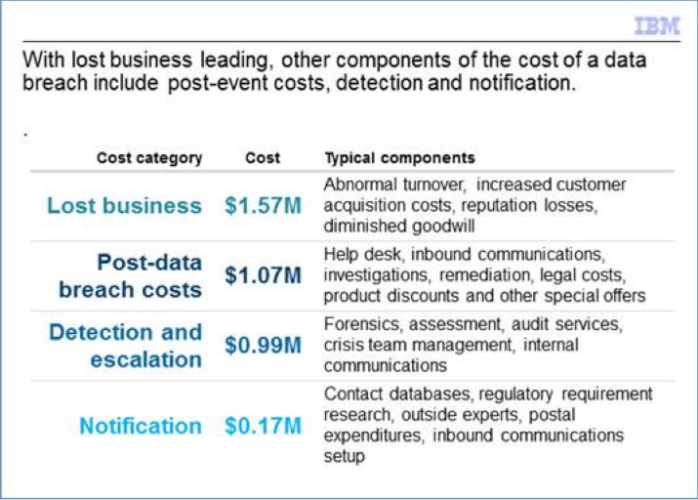
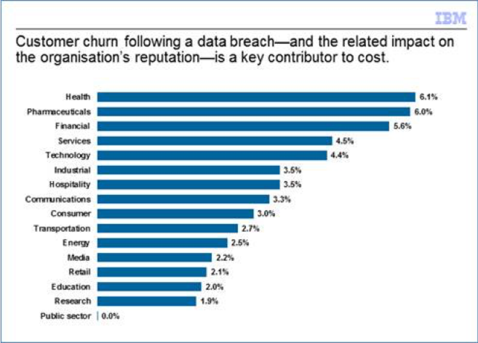
Notes:
IBM/Ponemon study 2015

Slide 24
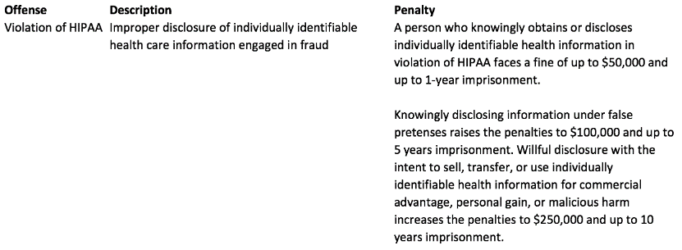
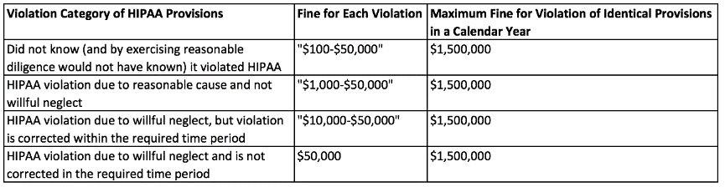
Notes:
IBM/Ponemon study 2015
HIPAA costs

Slide 25
Software Updates
“OWASP Top 10 for IoT”
Susceptible to MITM
Relatively easy to address in centralized scenarios, but difficult to deploy in standalone apps
Updating embedded devices is trickier
Unconventional constraints and threats
New risks
Signed updates require PKI/always on system
Unsigned updates is the norm
Notes:
OWASP top 10 for IoT – very similar to web and mobile, biggest difference is about software updates.
Difficult to patch. Cars need to be recalled to the vendor, except for some vendors. If there is an update capability, it is often insecure.
Updating and patching web application - relatively easy. Mobile phones = initially difficult, now easy. Cars = very difficult, they can stay unpatched for 15 years. They are going to be out there for a very long time and will not be patched.
HP research on smartwatches. 70% download patches without encryption.
Rapid7 on baby monitor systems. Several are completely broken. The whole market is broken.
Skynet from Terminator is awaiting us.

Slide 26
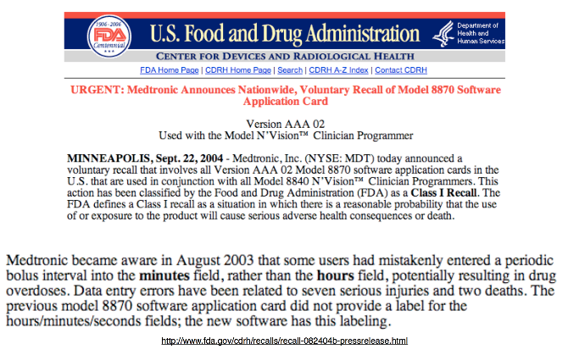
User Interface Updates
Notes:
User‘s interface screw-up
Software updates can disorient the users and have health hazards‘ impacts!

Slide 27
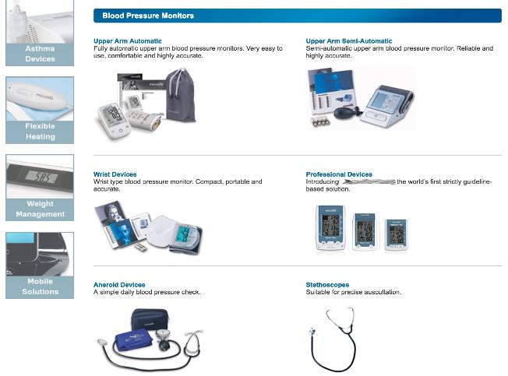
Notes:
Home medical devices

Slide 28
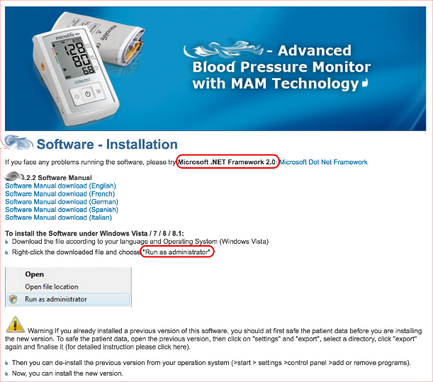

Slide 29
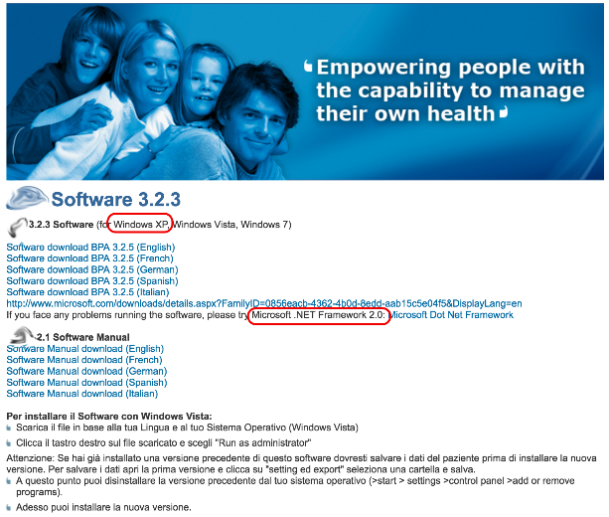

Slide 30
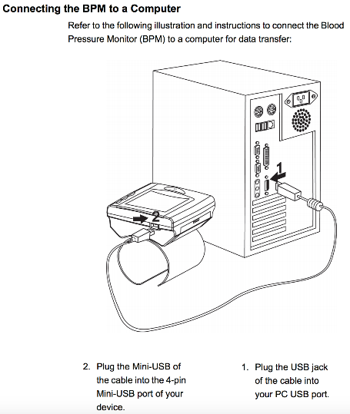

Slide 31
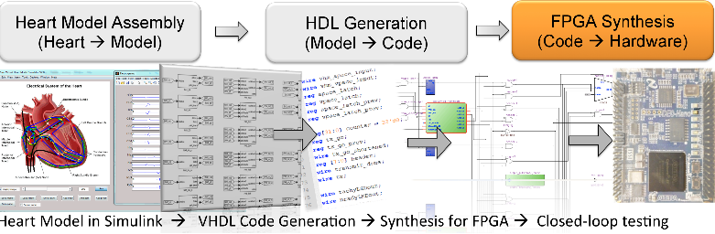
Notes:
This is how you program a pacemaker

Slide 32
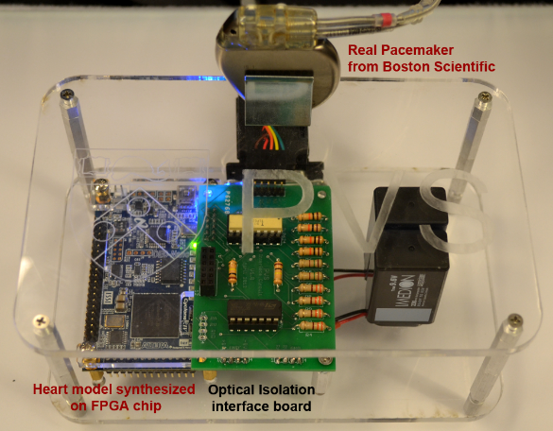
Notes:
This is how you debug a pacemaker

Slide 33
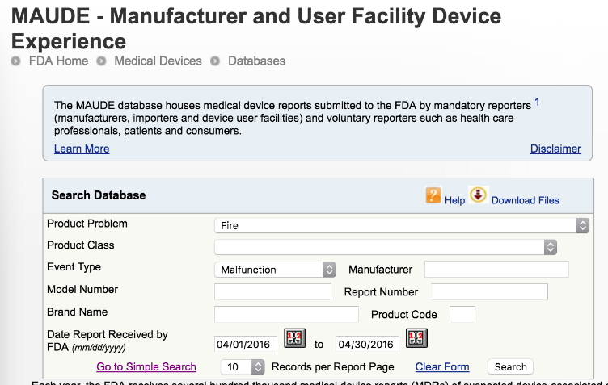
Notes:
FDA database search

Slide 34
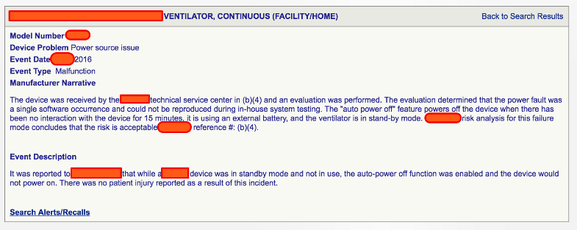
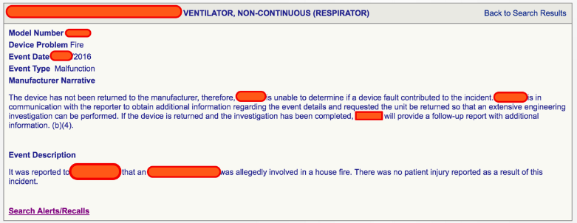

Slide 35
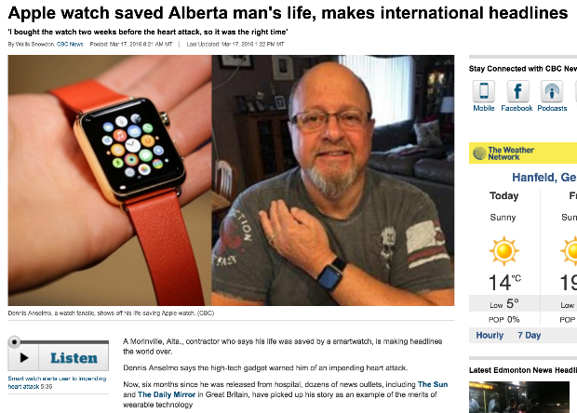
Notes:
Wearable – Apple Watch

Slide 36
Regulatory background

Slide 37
Medical Devices’ Cybersecurity Req’s (USA)
FDA CFR Title 21, Part 11 – Electronic Records; Electronic Signatures
FDA CFR Title 21, Part 820 – Quality System Regulation/MD GMP
FDA “Content of Premarket Submissions for Management of Cybersecurity in Medical Devices”
FDA “Cybersecurity for Networked Medical Devices Containing Off-the-Shelf (OTS) Software”
FDA “Postmarket Management of Cybersecurity in Medical Devices” (DRAFT)
Framework for Improving Critical Infrastructure Cybersecurity (NIST Cybersecurity Framework)
ISO14971:2007 “Application of risk management to medical devices”
ANSI/AAMI/IEC 80001-1 “Application of Risk Management for IT-Networks Incorporating Medical Devices”
Notes:
ISO/IEC 270xx – Information security management systems
ISO/IEC 27001 Requirements
ISO/IEC 27002 Code of Practice
ISO/IEC 27032:2012 – Guidelines for Cybersecurity

Slide 38
FDA CFR Title 21, Part 11 – ERES
2003, 2014, 2016
Manufacturers must implement controls, including
Validations
Audit Trails, documentation for software and systems
Method to retain legacy systems
Record Retention
Electronic Signatures
Practically speaking: use PGP for FDA submissions
15 reasons not to use PGP: http://secushare.org/PGP
No good Authority, no FS, old crypto, incompatibilities, relies on email (in)security, bad key usage, etc.
Notes:
FDA CFR 21 part 11
Regulation on Electronic Records and Electronic Signatures (ERES) (2003)
It requires that manufacturers implement controls, including audits, system validations, audit trails, electronic signatures, and documentation for software and systems involved in processing the electronic data that FDA predicate rules require them to maintain.
A predicate rule is any requirement set forth in the Federal Food, Drug and Cosmetic Act, the Public Health Service Act, or any FDA regulation other than Part 11.
References
ISO/IEC 17799:2000 Information technology – Code of practice for information security management
ISO 14971:2002 Medical Devices – Application of risk management to medical devices
PGP habits of truncating fingerprints, collision attacks

Slide 39
FDA CFR Title 21, Part 820 – QSR MD CGMP
1978, 1996
FDA CFR 21 part 820
Subpart C 820.30 “Design Controls”
Subpart J 820.100 “Corrective and Preventive Action”
Compliance management issues
Patient’s consent
Need to disconnect/tokenize EU users
Healthcare provider: data processors
Notes:
FDA CFR 21 part 820 Quality System Requirements
Medical Devices CGMP – Current Good Manufacturing Practice
The requirements for quality controls, history record keeping, complaints management etc. have all an impact on IT systems.
E.g. theoretically should register complaints coming from Facebook
Need to disconnect/tokenize EU users
Subpart J 820.100 “Corrective and Preventive Action” – must include Cybersecurity
“Each manufacturer shall establish and maintain procedures for implementing corrective and preventive action.”

Slide 40
FDA – Premarket Submissions for Management of Cybersecurity in Medical Devices
2014
Not compulsory
Recognise additional risks for “connecting” devices
Manufacturers should
“address cybersecurity during design and development phase”
“establish design inputs for their device related to cybersecurity”
“establish a cybersecurity vulnerability and management approach”
requires specific Cybersecurity documentation
Hazard analysis, traceability matrix, secure updates, software integrity, additional Cybersecurity controls
employ NIST Cybersecurity Framework
Notes:
The FDA, as a part of its Content of Premarket Submissions for Management of Cybersecurity in Medical Devices (June 2013)
The scope of the Guidance covers the following:
510k, de novo submissions, Premarket Approval Applications (PMAs), product development protocols, and humanitarian device exemption
(510k is a premarket submission made to FDA to demonstrate that the device to be marketed is at least as safe and effective, that is, substantially equivalent, to a legally marketed device (21 CFR §807.92(a)(3)) that is not subject to premarket approval).
Devices capable of connecting via wireless or wired, Internet or networks, or portable media
Encourages medical device manufacturers to produce evidence that their ISO 14971 risk management process considered information security risks to the medical device, and addressed those risks with appropriate security controls as part of the device’s „design and development”
Manufacturers should establish design inputs for their device related to cybersecurity, and establish a cybersecurity vulnerability and management approach as part of the software validation and risk analysis that is required by 21 CFR 820.30(g).
Cybersecurity documentation: hazard analysis, traceability matrix between risks and controls, plan to provide validating software updates, summary of controls to keep software integrity, instruction with additional requirements such as firewall, AV, etc.
Calls for NIST Cybersecurity Framework for critical infrastructure (2014) in the context of hospitals

Slide 41
FDA – Premarket Submissions – issues
Risk assessment is focused on patient’s health, not Cybersecurity risks
Besides patients’ risk, hospital’s networks are in scope
FDA does not necessarily question the content
No verification/test of effectiveness is required
Notes:
Not holistic approach. E.g. if a risk is targeted at backend application,

Slide 42
FDA “Cybersecurity for Devices Containing Off-the-Shelf Software”
2015
Not compulsory – “current thinking” of FDA
Focus on OTS software which connects to the Internet
also “useful” for network administrators and IT vendors
Medical device vendor is responsible for Cybersecurity
Clarifies that CFR 820.100 also includes Cybersecurity
Notes:
FDA on OTS Software
Like POS, ATM, smartphones etc., medical devices also run embedded OSes (Windows XP-E, VxWorks, QNX) which can have vulnerabilities
“Cybersecurity vulnerability”
Focus on risks affecting the performance of the device and health of the patient
Duty to “systematically analyze sources of information and implement actions needed to correct and prevent problems” as described into 820.100 - “Corrective and Preventive Action”

Slide 43
FDA “Postmarket Management of Cybersecurity in Medical Devices” (DRAFT)
2016
Recommends NIST Cybersecurity Framework
“Identify, Protect, Detect, Respond and Recover”
Recommends ISO14971 for risk assessment
Monitor Cybersecurity information sources
Assessing impact of vulnerabilities (using CVSS)
Establish need of a process for handling vulnerabilities
Deploy early mitigations
Notes:
NIST Cybersecurity Framework
President Order, Improving Critical Infrastructure Cybersecurity, in February 2013.
Framework for Improving Critical Infrastructure Cybersecurity, February 2014.
Focus on the three components: Confidentiality, Integrity, Availability (CIA)
Focus on critical infrastructure (healthcare facilities)
Applying the 2014 NIST voluntary Framework for Improving Critical Infrastructure Cybersecurity, which includes the core principles of “Identify, Protect, Detect, Respond and Recover”;
Monitoring cybersecurity information sources for identification and detection of cybersecurity vulnerabilities and risk;
Understanding, assessing and detecting presence and impact of a vulnerability;
Establishing and communicating processes for vulnerability intake and handling;
Clearly defining essential clinical performance to develop mitigations that protect, respond and recover from the cybersecurity risk;
Adopting a coordinated vulnerability disclosure policy and practice; and
Deploying mitigations that address cybersecurity risk early and prior to exploitation.

Slide 44
FDA “Postmarket Management of Cybersecurity” (DRAFT) – issues
Only a “guidance”, with little compulsory sections
Not binding for device compliance
Risk context is Quality, not Security
No difference for what concerns different levels of risk – threat modelling is very simple
Does not encourage an efficient way of elaborating an ISMS
Simplistic mitigation procedures
Who ensures mitigation procedures are followed?
What is the boundary that triggers the need for re-approval?
“Security patch” is not panacea
Notes:
Voluntary use - guidance: the usage is “recommended”
NIST Framework is focused on Critical Infrastructure
Risk context is Quality, not Security
Risks are only considered regarding “Essential Clinical Performance”
Although the document defines a method for evaluating those risks, there is no difference in consequence or treatment of vulnerabilities, remediation, reporting etc. depending on this risk.
Reporting a threat that can potentially manipulate a shot in an insulin pump or cardiac pacemaker, is the same as one that can falsify the reading of thermometer for home use.
If everything is treated in the same way, the risks are that:
We have an inefficient process for risk assessments (does a start-up producing FitBit-like device need to have a fully developed ISMS program? It seems an overkill)
We could underestimate threats on life-saving devices (can an insulin pump maker decide NOT to use the NIST framework? It seems like so)
Approach for mitigating risks is too simplistic. The proposed approach is basically “black or white” for what concerns compensating controls. Either the problem is “controlled” and has a mitigation, or it doesn’t.
Grey area: let’s say the mitigation is disconnecting the device from the network; who does insure that this is happening? Who is taking effective responsibility for this mitigation being in place? Is that the patient, the hospital, the manufacturer? Are we sure a patient keeping the device plugged to the cable is not going to sue the manufacturer anyway if they get hacked?
Another issue is the fact that security patches are basically considered out of radar in terms of clinical performance. They can be issued on devices without having to file an FDA change. This is probably established to encourage patching from manufacturers and FDA processes are complex. However, this also assumes that a security patch won’t affect the clinical performance.
The document does not specify boundaries or limits by which a patch would or would not trigger an FDA re-approval for change. History of cybersecurity is full of security patches which have caused functionality problems.

Slide 45
FDA “Postmarket Management of Cybersecurity” (DRAFT) – suggestions
Link compliance to risk levels
Have different approaches for life-sustaining devices and simpler ones - build a threat modelling based on risk
Require the ability to „fail safe“ and have signed, protected applications running diagnostic and therapeutic algorithms
Require separation of software modules, and declare which ones trigger re-certification and which one does not
Notes:
Suggestions:
Link compliance with risk levels. It would also be useful to link different levels of compliance to be reached, depending on the level of safety risks that can harm a user/patient (in the document defined as “Risk to Essential Clinical Performance”).
Although ISMS/risk management process should be the same in principle, it could be expected the FDA would provide different routes for outcomes if e.g. a device is life-sustaining or not, it is connected to network infrastructure or not, it is connected to other devices (mesh/IoT approach) or not.
What is really missing is the approach from the information security point of view. The document mostly refers to quality management principles, and security principles are basically just delegated to the NIST framework. What is missing is exactly what we should expect from the document, that is, a connection of the two.
Threats are classified only as “controlled” or “uncontrolled” (483-488), and define remediation and reporting based on a black and white chart (452-478) or short-lived examples (419-668). Maybe, it would be more useful to identify basic characteristics of devices which can have influence to their risk profiles.
Guidance suggests companies should build one threat modelling, using CVSS
It would be safer to require some form of separation, for instance, “chrooting” different parts of the device – communication layer, cryptography section, clinical performance layer, user interface layer, etc. – and have clear interfaces between them. FDA should then mandate documented testing of the interfaces and certification of each layer. Then they should say e.g. that changes in the clinical performance layer must mandate re-approval, while patching the communication layer or interfaces (which are the ones that most likely will require frequent security patches and/or can impose mitigations) will not affect clinical performance and therefore will not trigger FDA re-certification.

Slide 46
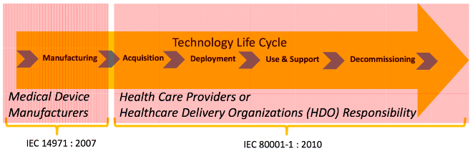
ANSI/AAMI/IEC 80001-1
2010 – started in 2005
Match at the network level the IEC 14971 standard
Destined to healthcare providers (hospitals)
MDDSs require FDA registration/Responsibility Agreement
Safety, Effectiveness, Data and System Security
Notes:
As a consequence of rapid system proliferation and the lack of appropriate support guidelines & infrastructure, there have been a growing number of reported system failures with serious consequences since the year 2000
Recognizing this problem, in December 2005 a meeting was convened at FDA headquarters with expert representatives from medical device manufacturers, healthcare providers (clinical engineering) and other relevant parties to discuss the problem (i.e., how to deal with increasing number of systems with new vulnerabilities).
The meeting concluded that
while manufacturers had guidelines for effectively risks associated with the development and manufacture of medical devices/systems (e.g., IEC 14971),
there were no comparable, adequate guidelines that healthcare providers could employ to insure the medical devices/systems they deploy
- MDDS (Medical device data system), can be sw/hw

Slide 47
Medical Devices’ Cybersecurity Req’s (EU)
European Network and Information Security (NIS) directive
“The Alliance for Internet of Things Innovation (AIOTI)”
IEC 80001-1 “Application of Risk Management for IT-Networks Incorporating Medical Devices”
ISO/IEC 270xx standards
Notes:
European Network and Information Security (NIS) directive
Only directed to public sector
- EC 80001-1: The standard focuses on the high-level actions that a healthcare facility should undertake when connecting medical devices to the hospital IT network.
ISO/IEC 270xx – Information security management systems
ISO/IEC 27001 Requirements
ISO/IEC 27002 Code of Practice
ISO/IEC 27032:2012 – Guidelines for Cybersecurity

Slide 48
NIST Resources
SP 800-66: An Introductory Resource Guide for Implementing the Health Insurance Portability and Accountability Act (HIPAA) Security Rule
SP 800-61: Computer Security Incident Handling Guide DRAFT SP 800-53: Recommended Security Controls for Federal Information Systems
SP 800-55: Security Metrics Guide for Information Technology Systems
SP 800-50: Building an Information Technology Security Awareness and Training Program
SP 800-42: Guideline on Network Security Testing
SP 800-35: Guide to Information Technology Security Services
SP 800-34: Contingency Planning Guide for Information Technology Systems
SP 800-30: Risk Management Guide for Information Technology Systems,
SP 800-27 Rev. A: Engineering Principles for Information Technology Security (A Baseline for Achieving Security)
SP 800-26: Security Self-Assessment Guide for Information Technology Systems
Notes:
http://csrc.nist.gov/publications/nistpubs/

Slide 49
Other Resources
ECRI publications
“Security Guide for Biomedical Technology”
“How FDA Sees Cybersecurity”
ISO/IEC 60601‐1 (2005)
HIMSS/NEMA HN 1‐2008 Manufacturer’s Disclosure Statement for Medical Device Security (MDS2)
MIL‐STD‐882E DOD’s Standard Practice for System Safety
ACCE ECRI Security Guide for Biomedical Technology
The Joint Commission Sentinel Event Alert #42: Safely implementing health information and converging technologies, December 11, 2008
Systems Engineering Guide for Systems of Systems, Version 1.0 (ODUSD), 2008
Notes:
www.ecri.org
ISO/IEC 60601‐1 (2005), Medical Electrical Equipment requires manufactures to include some information in accompanying documents if medical equipment is to be connected to an IT network
http://www.system‐safety.org/Documents/MIL‐STD‐882E‐Feb05.doc
Office of the Deputy Under Secretary of Defense for Acquisition and Technology, Systems and Software Engineering. Washington, DC: ODUSD(A&T)SSE, 2008. DOD, Aug 2008

Slide 50
Suggestions for improvements

Slide 51
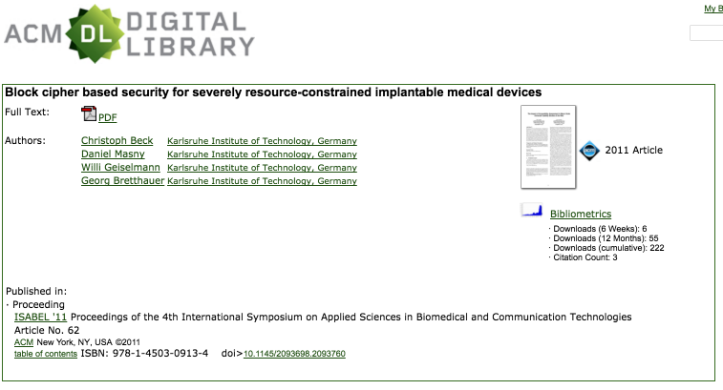
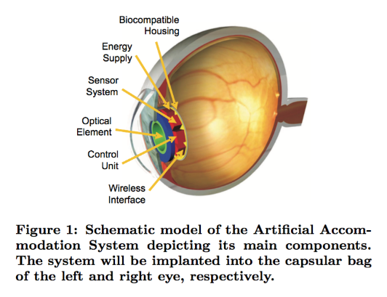
Suggestions for improvements
Network Communication Standardisation
Including security interfaces
Regulation step-up
Making cybersecurity prescriptive / revise 501k
Simplify the normative jungle
Change thinking paradigms of Medical Devices manufacturers
Collaboration between P&D and InfoSec/Risk Management
“Security should be evaluated according for impact on safety”
Less simplistic approach for FDA Cybersecurity Risk Assessments
Cybersecurity!
Security by design (as required by new EU GDPR)
Re-use existing frameworks as much as possible
Implement advanced OS security (e.g. signed updates, fail safely)
Harvest on technological advances
Notes:
501k = premarket notification
Collaboration: safety specialists already focus on risk management, security people focus on technical controls
Need to have both working together, without interrupting clinical workflow
Need to accept the risk sometimes
Secure-medicine.org
Risk assessment: model driven safety analysis from IEEE
ISO/IEC 270xx – Information security management systems
ISO/IEC 27001 Requirements
ISO/IEC 27002 Code of Practice
ISO/IEC 27032:2012 – Guidelines for Cybersecurity

Slide 52
”I am the Cavalry” Hippocratic Oath
Cyber Safety by Design: I respect domain expertise from those that came before. I will inform design with security lifecycle, adversarial resilience, and secure supply chain practices.
Third-Party Collaboration: I acknowledge that vulnerabilities will persist, despite best efforts. I will invite disclosure of potential safety or security issues, reported in good faith.
Evidence Capture: I foresee unexpected outcomes. I will facilitate evidence capture, preservation, and analysis to learn from safety investigations.
Resilience and Containment: I recognize failures in components and in the environment are inevitable. I will safeguard critical elements of care delivery in adverse conditions, and maintain a safe state with clear indicators when failure is unavoidable.
Cyber Safety Updates: I understand that cyber safety will always change. I will support prompt, agile, and secure updates.
Notes:
https://www.iamthecavalry.org/domains/medical/oath/

Slide 53
Questions?

Slide 54
Thank you

